Slide 1


PROJECT 3 HR DATA ANALYSIS

Slide 2
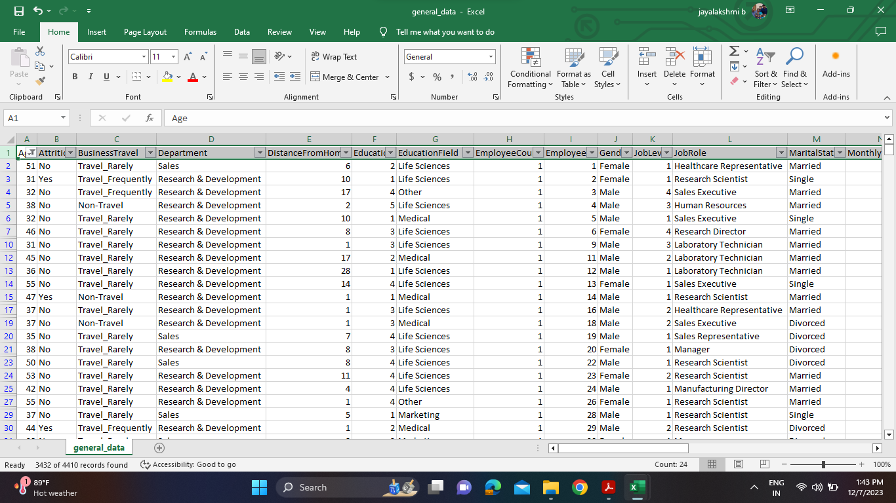
Using Excel, how would you filter the dataset to only show employees aged 30 and above?

Slide 3
Create a pivot table to summarize the average Monthly Income by Job Role.
Job Role | Average of Monthly Income
Healthcare Representative | 60984
Human Resources | 58528
Laboratory Technician | 66314
Manager | 63396
Manufacturing Director | 69184
Research Director | 65473
Research Scientist | 64976
Sales Executive | 65187
Sales Representative | 65371
Grand Total | 65029

Slide 4
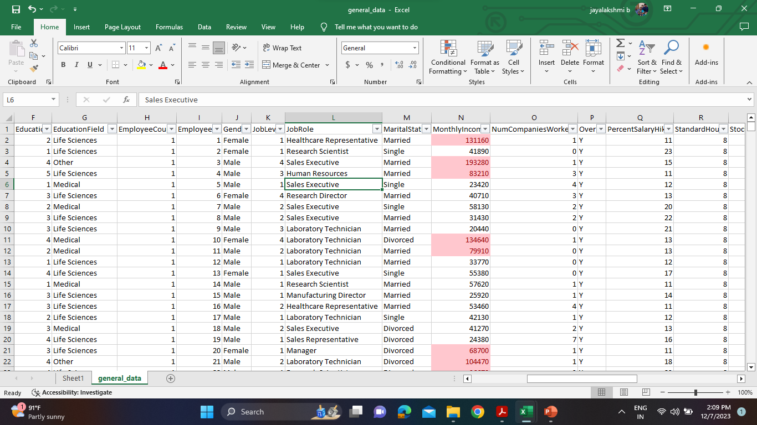
Apply conditional formatting to highlight employees with Monthly Income above the company's average income.

Slide 5
Create a bar chart in Excel to visualize the distribution of employee ages.

Slide 6
Identify and clean any missing or inconsistent data in the "Department" column.
There’s no missing or inconsistent data in the “Department” column.

Slide 7
Using Excel, create a pivot table that displays the count of employees in each Marital Status category, segmented by Department.
Count of Employee | Marital Status
Department | Divorced | Married | Single
Human Resources | 21 | 96 | 72
Research & Development | 621 | 1350 | 912
Sales | 339 | 573 | 426

Slide 8
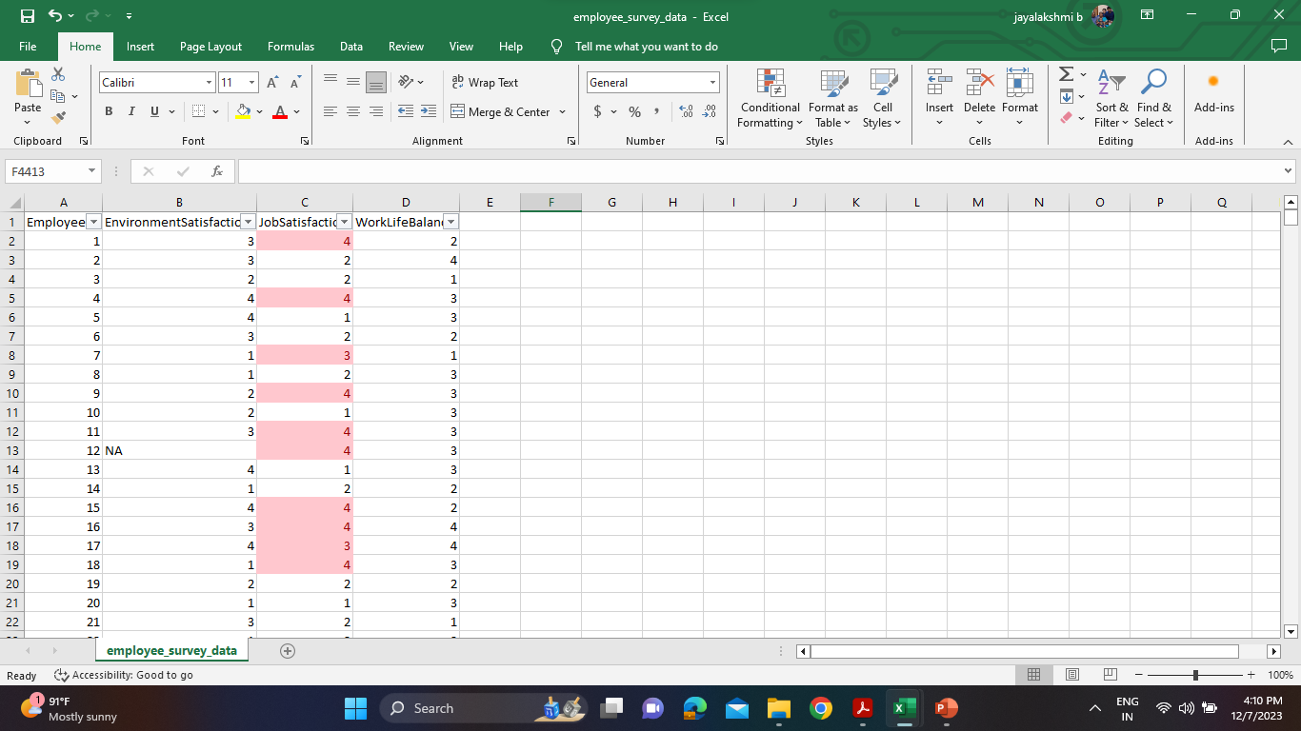
Apply conditional formatting to highlight employees with both above-average Monthly Income and above-average Job Satisfaction.

Slide 9
In Excel, calculate the total Monthly Income for each Department, considering only the employees with a Job Level greater than or equal to 3.
Total Monthly Income | Job Level greater than or equal to 3
Department | No | Yes
Human Resources | 7684800 | 3259140
Research & Development | 140199990 | 53502900
Sales | 59158110 | 22974330

Slide 10
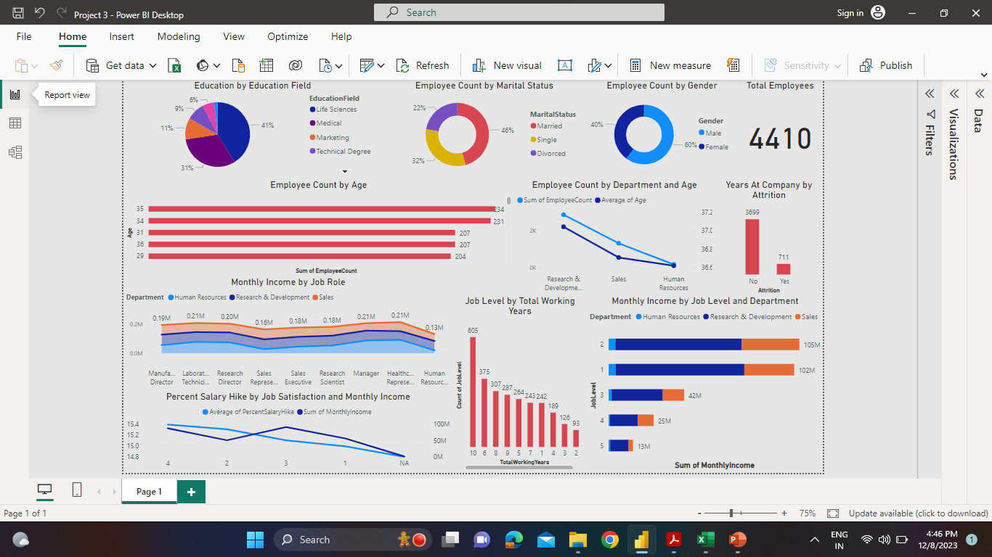
POWER BI DASHBOARD

